Slide 1





SPOTIFY MUSIC RECOMMENDATION SYSTEM
Name : KALAISELVAN K
Email id: kkalaiselven48@gmail.com Guide: P.RAJA
Disclaimer: The content is curated for educational purposes only.
Notes:
Slides: Prepare a short slide deck (10-12 slides) summarizing the project objectives, methodology, and key results.

Slide 2
OUTLINE
Abstract of the Project
Problem Statement
Proposed Solution
System Architecture
Live Demo of the Project
Embedded Video of Project
Conclusion
Future Scope

Slide 3
Abstract The "Spotify Music Recommendation System" project aims to enhance the music discovery experience by providing users with personalized, diverse, and dynamic song recommendations. Leveraging a hybrid recommendation approach, the system combines content-based filtering analyzing audio features like danceability, energy, and tempo with popularity-based metrics and the recency of tracks. This approach ensures that users receive not only relevant recommendations based on their musical preferences but also discover new, trending songs. By improving the accuracy and variety of suggestions, the system addresses the limitations of traditional recommendation methods, offering users a more engaging and enjoyable listening experience. The ultimate goal is to create a recommendation engine that adapts to users' evolving tastes and introduces them to both mainstream and hidden music gems.

Slide 4
Problem Statement The Spotify music recommendation system aim to provide personalized song suggestions to uses based on their musical preferences. Leveraging machine learning techniques and the Spotify dataset, the system analyzes song attributes like danceability, energy, and tempo to group songs into clusters with similar characteristics. User interact with the system by inputting their favorite song and, optionally, specifying a preferred genre. The system then generates curated list of recommended tracks that align closely with the user’s preference. Key objectives include accurate recommendation generation, efficient data analysis and preprocessing, seamless user interaction, and scalability to handle large volumes of data. Ultimately, the goal is to enhance the music discovery experience for user, empowering them to explore new music that resonates with their unique tests and preferences while fostering a deeper connection with the Spotify platform.

Slide 5
Proposed Solution The proposed solution utilizes the Spotify song dataset from kaggle to generate personalized songs recommendations. By employing k-means clustering ,data points are grouped based on attributes like danceability, energy, and tempo, aiding in identifying similar tracks. users input their favorite songs and optionally specify preferred genres for refined recommendations. leveraging the clustering model, the system suggests song from the same cluster as the user’s favorite, ensuring alignment with their musical preferences. Deployed as a standard python application, the recommender system offers seamless accessibility to use. Continuous refinement based on user feedback and performance evaluation enhances that system’s accuracy, improving the overall music discovery experience for Spotify users.

Slide 6
System Architecture The Spotify Music Recommendation System’s architecture integrates multiple layers to provide users with tailored music recommendations. It begins with the data collection layer, where Spotify’s API is used to gather song metadata and audio features like danceability, tempo, energy, and popularity. This data is then preprocessed in the data processing layer, where audio features are normalized to ensure consistency, and relevant metrics such as weighted popularity are calculated to prioritize more recent, trending songs. The recommendation engine serves as the core of the architecture, combining content-based filtering with hybrid recommendation techniques to analyze user inputs and generate similar song recommendations based on audio characteristics and popularity. Finally, the user interface layer displays the recommendations in an accessible format, allowing users to input their preferred song and immediately receive a curated list of suggested tracks

Slide 7
Live Demo of Project The live demo of the Spotify Music Recommendation System offers users an interactive experience to explore personalized music recommendations based on their chosen song or artist. Upon launching the demo, users are prompted to enter a song name, and the system uses this input to retrieve and analyze relevant audio features from Spotify’s API. The recommendation engine then processes these features to generate a list of similar songs, balancing the influence of popularity and content-based metrics. The demo interface displays the recommended tracks, including song titles, artists, and release details, providing an immediate look at the system's tailored recommendations. This live demonstration showcases the system's real-time processing capability and provides a glimpse into the potential for personalized music discovery powered by machine learning and Spotify’s extensive dataset.

Slide 8
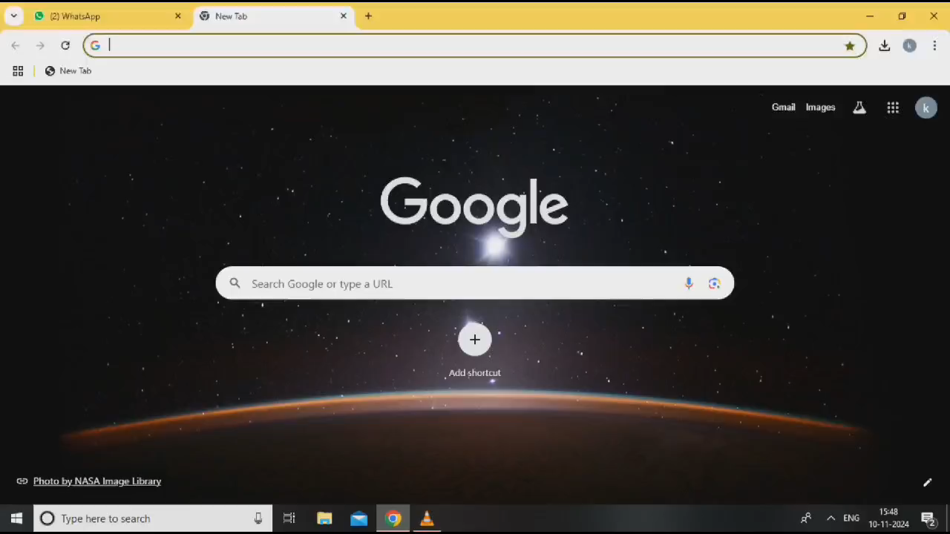
Video of Project Demo

Slide 9
Conclusion The recommendation system employed by Spotify has proven to be highly effective in accurately predicting and suggesting songs that align with the preferences of individual users. Through its sophisticated algorithms and data processing capabilities, the Spotify recommendation program has revolutionized the music discovery experience for millions of users worldwide. By leveraging a combination of advanced machine learning techniques, such as collaborative filtering and content-based recommendation, the system analyzes vast amounts of user data to generate personalized song recommendations tailored to each user's unique tastes and preferences. One of the key strengths of the Spotify recommendation system is its ability to cater to a diverse range of musical preferences. Whether users enjoy pop, rock, jazz, or any other genre, the recommendation engine is adept at identifying patterns and similarities in their listening habits to provide relevant song suggestions. This personalized approach not only enhances the user experience but also fosters a deeper connection between users and the music they love.

Slide 10
The success of the Spotify recommendation program can be attributed to several key factors. First and foremost is the system's ability to deliver accurate and relevant song suggestions to users. By leveraging advanced machine learning techniques, the recommendation engine is able to analyze vast amounts of data to identify patterns and similarities in users' listening habits, resulting in highly personalized recommendations. Furthermore, the recommendation system's user-friendly interface makes it easy for users to interact with the platform and provide feedback on the recommendations they receive. This feedback loop is essential for continuously improving the recommendation algorithms and ensuring that they remain relevant and effective over time. In conclusion, the Spotify recommendation system represents a significant advancement in the field of music discovery. By combining advanced machine learning techniques with a vast dataset of songs, Spotify has created a recommendation engine that is capable of delivering highly personalized song suggestions to users across the globe. With its seamless deployment and user-friendly interface, the recommendation system has become an indispensable tool for music lovers everywhere, enhancing the way they discover and enjoy music on Spotify.

Slide 11
Future Scope To elevate recommendation accuracy, the Spotify recommendation system could explore an array of advanced machine learning algorithms and techniques beyond the current scope of collaborative filtering and content-based recommendation. Diving into methodologies such as matrix factorization, deep learning, and ensemble methods presents an avenue for enhancing the system's capability to discern intricate patterns and subtle nuances within user preferences. By delving deeper into these methodologies, the system could uncover hidden correlations and dependencies within the vast array of user interactions and song attributes, thereby refining the accuracy and relevance of its recommendations. Moreover, the incorporation of hybrid recommendation approaches stands as a promising avenue for fortifying the recommendation strategy. Hybrid systems seamlessly integrate diverse recommendation algorithms, leveraging the strengths of each to compensate for individual weaknesses. By amalgamating collaborative filtering, content-based filtering, and possibly other recommendation techniques, the system could foster a more holistic and robust recommendation framework.

Slide 12
This fusion of methodologies not only broadens the system's repertoire but also enables it to adapt to varying user preferences and recommendation scenarios, ultimately enhancing the overall recommendation quality. In parallel with enhancing recommendation accuracy, enriching the user interface with additional features and customization options holds the potential to cater to a wider spectrum of user preferences and usage contexts. The integration of social features, such as friend recommendations or user-generated playlists, could foster a sense of community engagement and facilitate collaborative music discovery experiences. Empowering users with tools to curate their own playlists, share recommendations with friends, and discover music tailored to specific moods, activities, or occasions adds layers of personalization and interactivity to the music discovery journey.

Slide 13
Thank you!
Notes:
thank you very much for joining this PPT, keep learning.
13

